Slide 1
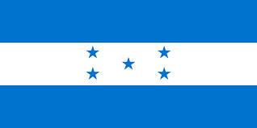
Republic of
Honduras
Mya Plyler

Slide 2
The capital of Honduras is Tegucigalpa!

Slide 3
Honduras has a constitutional republic government.Their president’s name is Juan Orlando Hernandez. He looks like this:

Slide 4
Demographics
The population of Honduras is 8.26 million people as of 2014.
90% of Hondurans are mestizo, 7% are amerindian, 2% are black, and 1% are white.
95% of Hondurans are Roman Catholic, and 5% are Other.

Slide 5
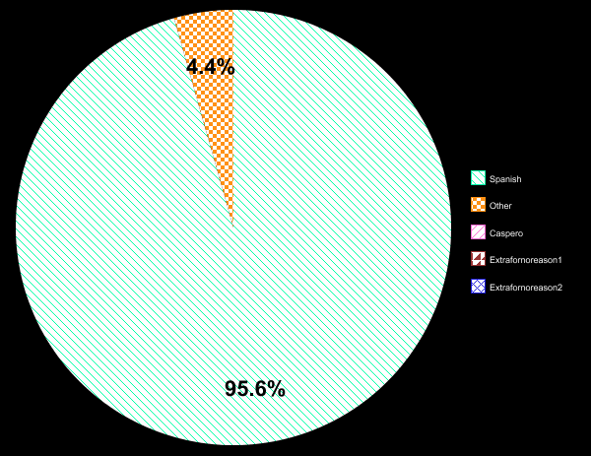
95.6% of Hondurans speak Spanish, 4.4% speak other, and the remaining 0% are mute and invisible-they all share the same name...Caspero.

Slide 6
MONEY MONEY MONEY
MONEY
Honduras’s currency is the Lempi, which is 21.3 lempi to 1 U.S. dollar.The average income of Hondurans is 2,070 lempi per year.

Slide 7
Major Exports
Major Imports
-Coffee
-Knit T-shirts
-Knit sweaters
-Insulated Wire
-Petroleum Gas
-Palm Oil
-Bananas
-Crustaceans
-Knit Socks and Hosiery
-Rolled Tobacco
-Refined Petroleum
-Non-Retail Pure Cotton Yam
-Non-Retail Synthetic Staple Fibers Yarn
-Packaged Medicaments
-Delivery Trucks
-Cars
-Computers
-Other Edible Preparations
-Coated Flat-Rolled Iron

Slide 8
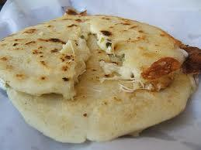
A popular food in Honduras are pupusas.
Instructions:
1)Mix the masa harina, cumin, salt and water into a dough which is soft but not sticky. Be prepared to add more flour if necessary. If it is too dry, add more water.
2)To make a 3 inch round papusa, take about half a cup of dough and roll it into a ball. flatten with your hand.
3)Put the filling in the centre [in this case, cheese, cilantro, salt and pepper].
4)Work the edges up over the filling and again form a ball, completely enclosing the filling.
5)Flatten each ball to about 1/4 inch or less and cook the pupusas on a hot, lightly oiled griddle for about 3 minutes per side, or until both sides are lightly browned.
6)Serve warm.
Pupusas Recipe:
Ingredients:
-2 cups masa harina
-1 ½ cups warm water
-1 tablespoon ground cumin
-salt for taste
-pepper to taste
-6 oz mild cheese (or filing of your choice
-½ cup fresh cilantro chopped

Slide 9
Fun Facts:
The term “Banana Republic” was first used in reference to Honduras, not the store.
There is only one natural lake in Honduras: Lake Yojoa
In Yoro, Honduras there is a phenomenon of fish rain. Fish literally fall from the sky!
September 10th is Honduran Child Day, and children receive gifts on this day as well as Christmas.
Comayagua, Honduras is home to one of the oldest clocks in the world.

Slide 10
Image sources:
http://upload.wikimedia.org/wikipedia/commons/8/82/Flag_of_Honduras.svg
http://2.bp.blogspot.com/-a4Gs_NQvHJE/UGAeTQ_iz3I/AAAAAAAAM_0/Dbp_SRke_hs/s1600/HONDURAS%2Bsept23012.jpg
http://media.giphy.com/media/xRJZH4Ajr973y/giphy.gif
http://iamtalkytina.com/wp-content/uploads/2013/08/jim_groom_dance_MOD.gif
http://media.giphy.com/media/11BqHsFlS9bKNO/giphy.gif
https://internationalpressclub.files.wordpress.com/2013/08/juan-orlando-hernandez-partido-nacional-de-honduras-national-party.jpg
http://www.picgifs.com/graphics/s/strawberries/graphics-strawberries-666872.gif
http://www.netanimations.net/Clip-art-images-of-Ghosts-Ghouls-Goblins-Gnomes.htm
http://www.netanimations.net/Moving-picture-hopping-pot-of-gold-animated-gif.gif
http://animationsa2z.com/attachments/Image/drinks/drinks8.gif
http://www.gifs.net/Animation11/Clothing/Childrens_Clothes/T-shirt_3.gif
http://sassyauburn.files.wordpress.com/2013/01/animatedpalmtree.gif
http://www.northamericandrillingcorp.com/images/uploads/image001.gif
http://cdn.osxdaily.com/wp-content/uploads/2013/07/dancing-banana.gif
http://questgarden.com/79/09/6/090326165128/images/animated_green_semi_truck.gif
http://www.gifandgif.eu/animated_gif/Cars/Animated%20Gif%20Cars%20(15).gif
http://www.schools.msd.k12.or.us/columbus/Images/Animated%20Gifs/animated_computer_student_3.gif
http://www.brightledsigns.com/images/products/preview/24120-an.gif
http://www.pupusasrecipe.com/wp-content/uploads/2012/08/20080912PupusasCU.jpg
http://www.ps11music.com/tada.gif
http://www.gifs.net/Animation11/Holidays/Party/Confetti_canon.gif

Slide 11
Information sources:
http://www.nationsonline.org/oneworld/honduras.htm
http://worldpopulationreview.com/countries/honduras-population/
http://www.infoplease.com/ipa/A0855617.html
http://www.answerbag.com/q_view/2214288
https://www.google.com/webhp?sourceid=chrome-instant&rlz=1C1TSND_enUS473US473&ion=1&espv=2&ie=UTF-8#q=currency+in+honduras+compared+us+dollar
http://www.worldvision.org/our-impact/country-profiles/honduras
http://atlas.media.mit.edu/profile/country/hnd/
http://www.food.com/recipe/pupusas-220460
http://borninhonduras.com/2010/01/interesting-facts-about-honduras.html

